Slide 1

Joint Strategic Plan
Planning Committee
SESSION 3
NOVEMBER 21, 2023
LAST UPDATED: 2023.11.20

Slide 2
Virtual Meeting Tips
This session will be video recorded so click on ACCEPT
Type your name and chapter in the name field
Type your name, graduation year, chapter and email address in the Chat Window
Mute your microphone except when speaking
Post questions and ask to be recognized in the Chat Window
Voting will be via Zoom poll
The recorder will take minutes; they will be available before the next meeting
Powerpoint slides and other references will be posted online after the meeting
Facilitator Team

Slide 3
Co-Champion Welcome
Dr. Dan Bureau, Fraternity President
Ken Heys, Foundation Chairman
Co-Champions

Slide 4
Session 1 Highlights
Begin with Quo Vadis, “Where are you going?”
Recommendation to create a Joint Strategic Plan (JSP) that applies to the Fraternity and Foundation as well as collegiate chapters, alumni associations, and members.
Recommendation to approve the framework or approach to develop the JSP before starting the process.
The proposed framework includes defined roles, functions, and process.
  Roles: Champions, Planners, Participants, Observers, Audiences, Stakeholders, Implementors, Recorders, Facilitators
  Functions: Discovery, Decision Points, Deliverables and Task Organization
Co-Champions

Slide 5
Session 1 Highlights (con’t.)
The proposed process includes:
  Phase I – Preparatory
  Phase II – Define Roles and
  Participants
  Phase III – Discovery and
  Future State
  Phase IV – Create the JSP
  Phase V – Implementation
Phase | Proposed Start | Proposed Completion
I | CY23Q3 | CY23Q3
II | CY23Q4 | CY23Q4
III | CY24Q1 | CY24Q3
IV | CY24Q4 | CY25Q2
V | CY25Q3 | Ongoing
Co-Champions

Slide 6
Session 2 Highlights
Planning Committee
Facilitator Team
Recruiting Committee
Communications Committee
TBD
Expectations
JSP Process
  Frequent, broad communication
  Wide participation; manageable chunks
  Clear, actionable work
  Follow-through concerns
JSP Outcome
  Unified vision and consensus
  Actionable, measurable goals
  Focus on growth
Facilitator Team

Slide 7
Session 2 Highlights (con’t.)
JSP Implementation – Phase V
Annually, champions and planners assess the performance of both organizations and prepare new annual operating plans. They ensure the annual operating plans support the joint strategic plan.
Annually, champions and planners inform audiences and stakeholder groups of annual progress against the strategic plan and solicit feedback.
One year prior to the end of the joint strategic plan period, both organizations prepare to update the strategic plan using a mutually agreed upon framework.
Impacts of Creating a Joint Strategic Plan
During
  Increased workload and reprioritization of some tasks for staff, leaders, and volunteers
  Reallocation of resources – time and money
After Completion
  Increased effectiveness and efficiency of resources
  Increased accountability and responsibility
  Increased awareness of performance against annual operating plans
  Increased definition to priorities and programs, which indirectly helps with fundraising, recruiting new members, and establishing new chapters or recolonizing chapters
Facilitator Team

Slide 8
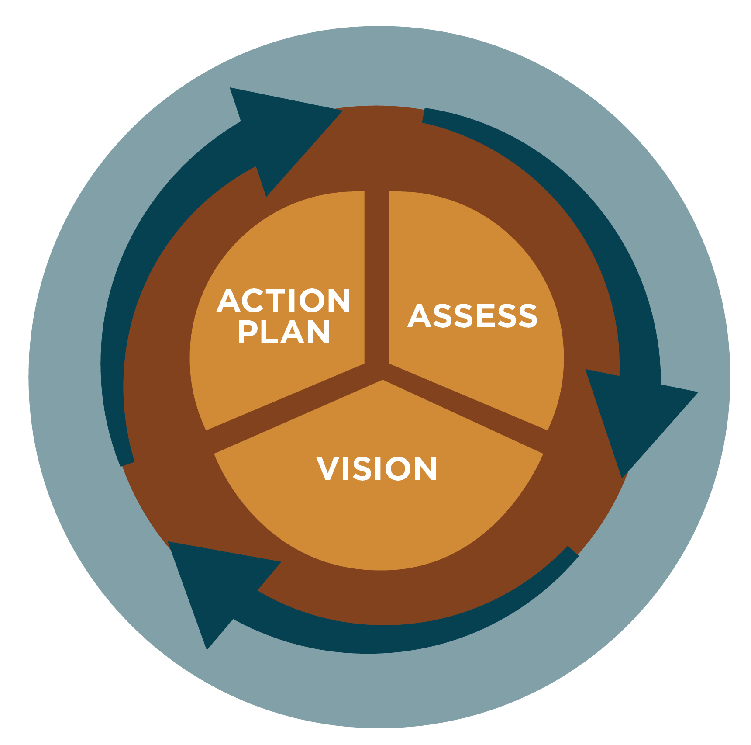
Session 2 Highlights (con’t.)
Things to Consider in Strategic Planning
Strategic Planning Cycle
Model of Complex Change Management
Assess how your organization is performing, identify benchmarks
Complete a SWOT analysis
The identity work of strategic planning - Mission, Vision, and Values - must be completed before moving into the Action Planning portion of a strategic plan. You simply can’t plan “how to get there” if you don’t know “where are you going?”
Action Planning begins with visioning
Facilitator Team

Slide 9
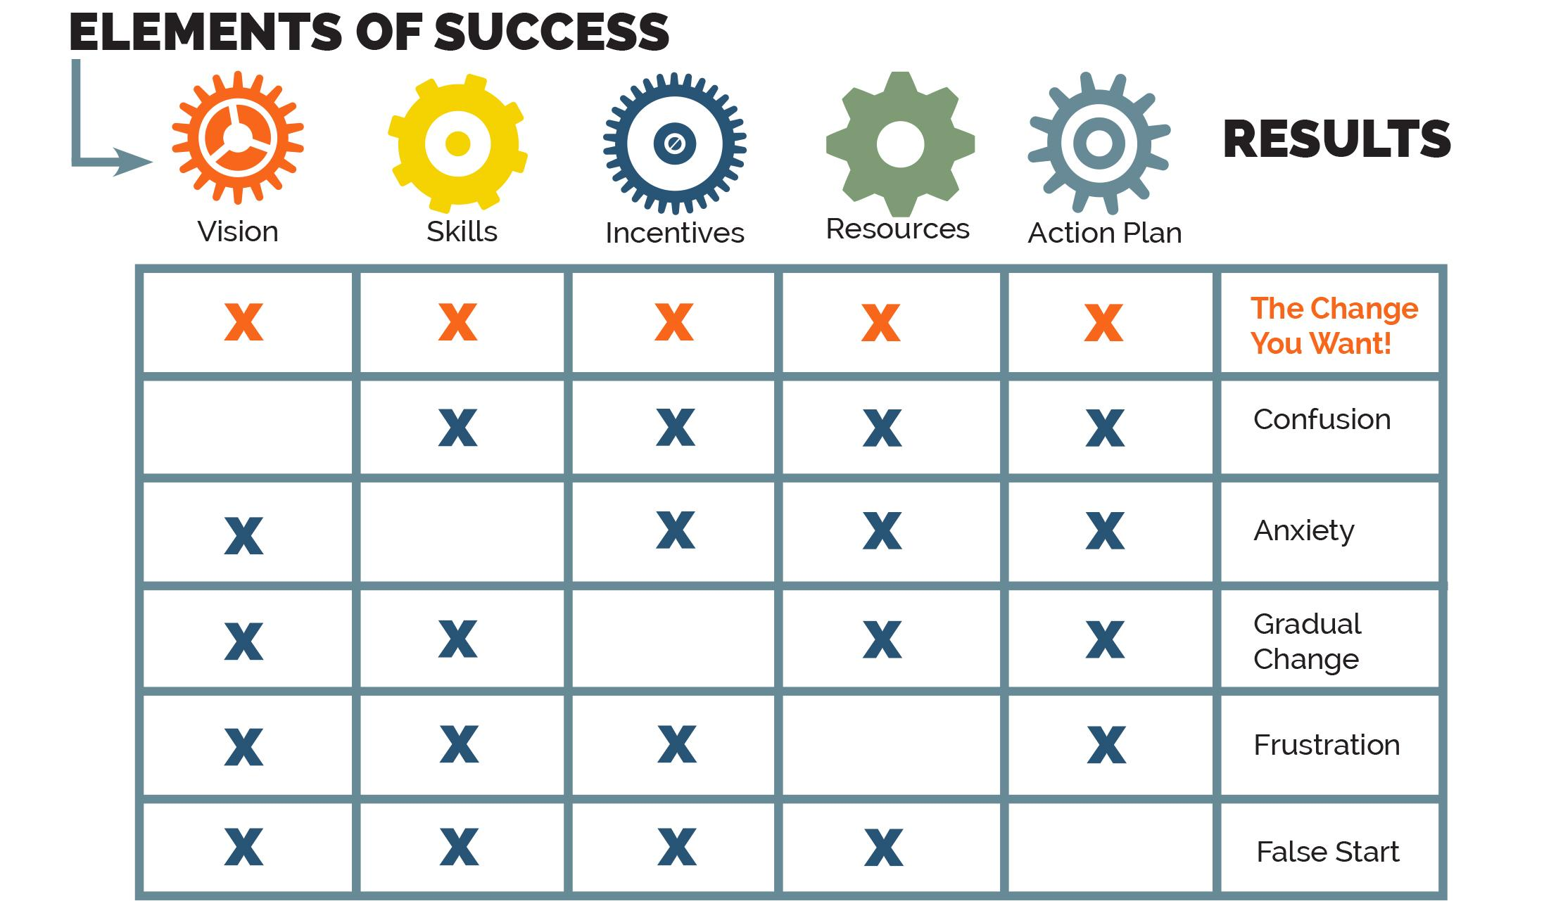
Session 2 Highlights (con’t.)
Model of Complex Change Management
Facilitator Team

Slide 10
Session 2 Highlights (con’t.)
Key Result Areas: Key Result Areas or KRAs are the overarching thematic focuses for our work throughout the duration of the plan.
Our plan should be limited to 3-5 KRAs. Big Hairy Audacious Goals (BHAGs) typically sit at the KRA level.
Goals: Under each KRA will lie 2+ Goals. Goals are the major accomplishments necessary to make progress toward the accomplishment of the KRA. Their timelines are usually 2+ years, though may not be time-bound.
Objectives: Under each goal may lie at least one objective, often several. Their timelines are usually 1-2 years. Objectives are the action steps required to accomplish the goal. Objectives should be SMART (Specific, Measurable, Achievable, Relevant, and Time-bound).
Facilitator Team

Slide 11
Session 2 Highlights (con’t.)
Metrics: Every objective must have at least one defined measure of success. Metrics are often quantitative - transactional or activity-based. Metrics can be qualitative or how well the organization is doing something (e.g., customer service). The organization must have tools and processes in place to gather data for metrics and report them consistently. The best metrics are SMART and performance-based. If you can’t or won’t measure something, don’t use it as a metric.
A Key Performance Indicator (KPI) is a single metric that is commonly used to report progress against an objective or even a goal, often in a dashboard. It is always SMART and performance-based.
Impact(s): Though not mandatory, it’s often helpful to note the desired impact(s) of each KRA. Impact statements are narrative descriptions of what is expected if the KRA is achieved.
Facilitator Team

Slide 12
Session 2 Highlights (con’t.)
Summary of Proposed Framework
Assess and Discovery Phase
  Current Strategic and Annual Operating Plans and Past Performance
  Environmental scans
  Strengths, Weaknesses, Opportunities, Threats (SWOT)
  Visioning and Big Hairy Audacious Goals (BHAGs)
Planning Phase - Creating the JSP
  Mission, Vision, Values –Affirm or Revise Phi Kappa Theta Identity
  KRAs
    Goals
      Objectives
        Metrics
  Impacts of KRAs
  Stakeholder Feedback
Facilitator Team

Slide 13
Session 2 Highlights (con’t.)
Closing “One Word” Responses
  Encouraged - 2
  Hopeful - 2
  Optimistic
  Ready
  Exciting
  Movement
  Progress
  Gratitude
Facilitator Team

Slide 14
Approve Minutes from Session 2
Questions or comments on highlights from previous sessions
Motion and second to approve the minutes
Vote
Co-Champions

Slide 15
Completed Actions since Session 2
Update to FRT Board
Expectations summary completed
Ground Rules Survey deployed, summary completed
Purpose Statement Survey deployed, summary completed
Prospect lists compiled and provided to Recruiting Committee
Biweekly Touchpoint sessions scheduled between Co-Champions, Executive Directors, and Facilitators
YouTube channel created for JSP
Added hybrid JSP session in conjunction with January Officers’ Academy
JSP landing page on phikaps.org website launched
Email with JSP interest survey sent to all collegiate and alumni brothers
Communications Committee Chairman identified
Proposed framework completed
Co-Champions

Slide 16
JSP Foundational Items
Co-Champions

Slide 17
Expectations – 18 Survey Responses
Based on your understanding of what was covered during Session 1 and the timeline to complete a Joint Strategic Plan (JSP) by May 2025, what are your expectations about the process for formulating a JSP?
Based on these results, our brothers expect an open, transparent, and well-communicated process that actively solicits participation from a wide cross-section of members and external stakeholders. Regular updates should be communicated to our entire membership to promote engagement and instill confidence in progress. Further, our brothers understand the complexity of the planning initiative and stress the need for smaller, focused working groups to drive outcomes.
What are your expectations about the results of a JSP?
By the end of the process, respondents expect a clear, forward-looking plan with a core focus on growth. Therefore, we should work to better define key areas that contribute to the growth of a fraternity and fraternal foundation, particularly emphasizing complementary areas between both organizations. With a large emphasis on implementation, the resulting strategic plan should have well-defined and measurable goals.
Co-Champions

Slide 18
Ground Rules – 18 Survey Responses
Give honest and constructive feedback
Focus on what’s best for the long-term of the fraternity
Agree/Disagree on ideas, not members of the organization
Adhere to your commitments and stay engaged
Open and frequent communication/accountability
Think boldly and bring forth big ideas, but consider resources
Use examples, not generalizations
Be patient, and also flexible
Consider the undergraduates and the founders
Co-Champions

Slide 19
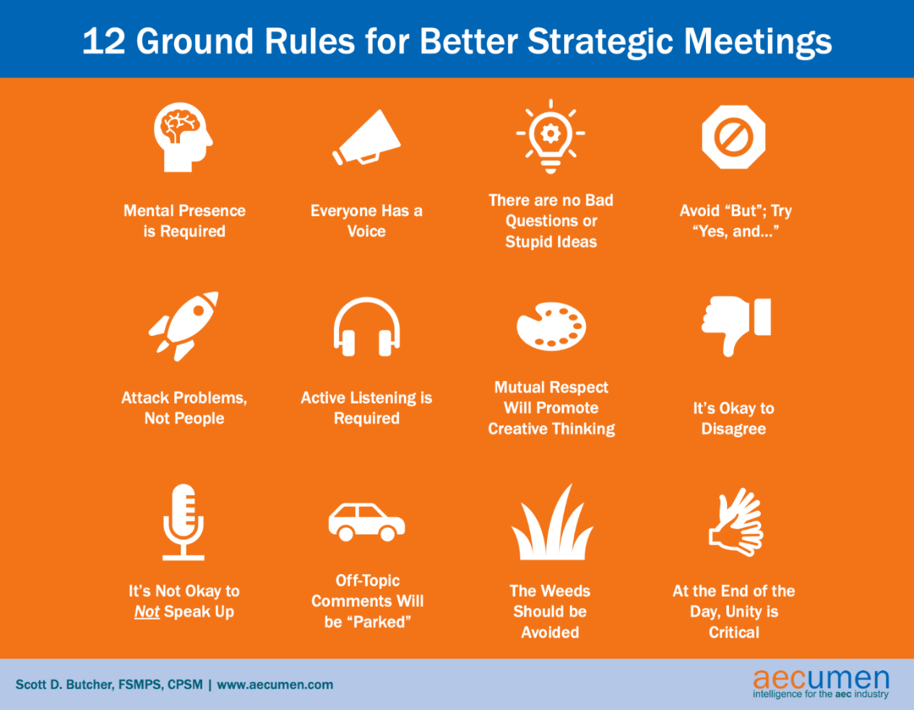
Co-Champions

Slide 20
Purpose – 18 Survey Responses
A defined process will enable us to develop a common vision for Phi Kappa Theta
Help bring alignment between the leadership of the Fraternity and Foundation
Ensure we create an achievable and realistic plan
Establish collective buy-in of our work and promote wide participation among our membership and stakeholders
Develop trust and provide accountability between Fraternity and Foundation
A plan will provide directional guidance, specific objectives, and measurable goals that align and promote our mission, vision, and values
Ensure the long-term survival and growth of the Fraternity
Co-Champions

Slide 21
Proposed Framework
Facilitator Team

Slide 22
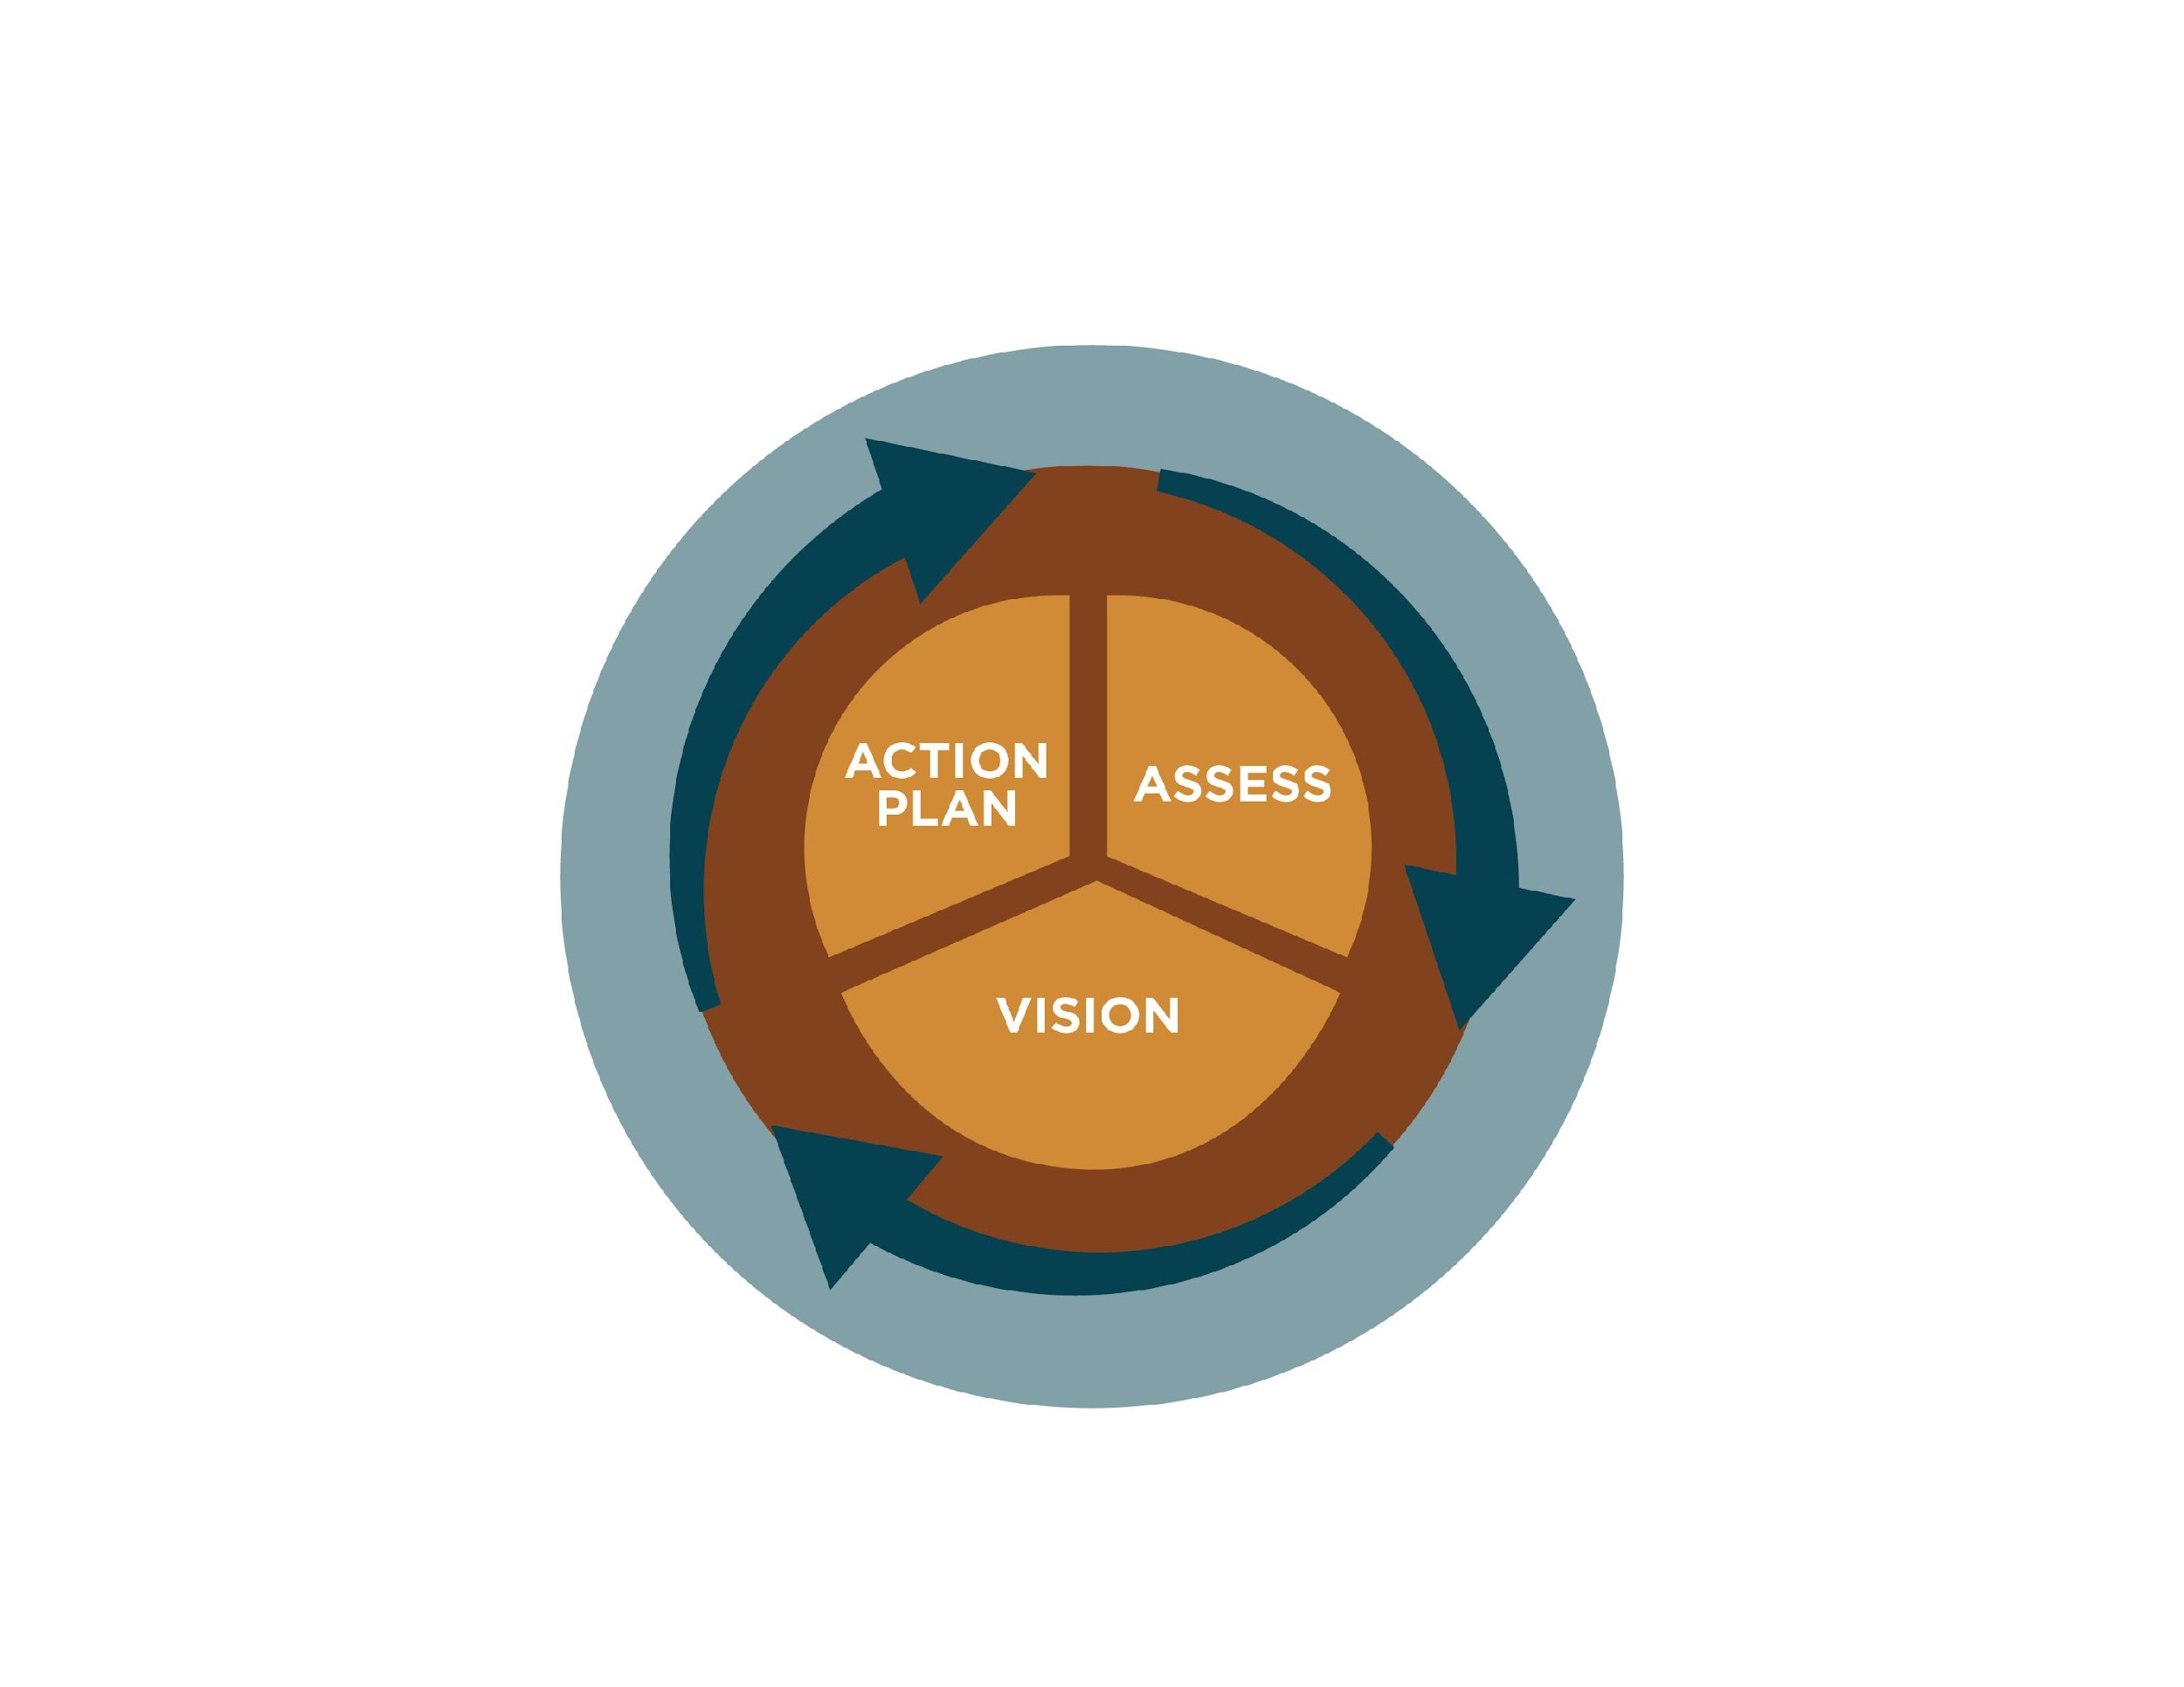
JSP Strategic Planning Cycle
Assess – Plan – Perform
Revised Cycle for JSP
Plan
JSP
Perform
Fraternity & Foundation
Assess
JSP
Revised cycle terms Assess-Plan-Perform
Importance of 360 Feedback during the Assess Phase
Importance of Environmental Scans during the Assess Phase
Facilitator Team

Slide 23
JSP Schedule
Revised Phase Schedule for JSP
Revised dates for phases III and IV
Phases:
  Phase I – Preparatory
  Phase II – Define Roles and
  Participants
  Phase III – Assess, Discovery,
  and Visioning
  Phase IV – Create the JSP
  Phase V – Implementation
Phase | Proposed Start | Proposed Completion
I | CY23Q3 | CY23Q3
II | CY23Q4 | CY23Q4
III | CY24Q1 | CY24Q2
IV | CY24Q3 | CY25Q2
V | CY25Q3 | Ongoing
Facilitator Team

Slide 24
Facilitator Team

Slide 25
Task Organization Chart
3 Committees and 3 Standing Teams
Planning Committee
Facilitator Team
Communications Committee
Recruiting Committee
Editing & Publishing Team
JSP Draft Team
Facilitator Team

Slide 26
Task Organization Chart
19 Task Teams – Assess Phase, Jan-Jul 24
Approaches
Research
Surveys
Focus Groups
Combined
FRT+FND Performance Assessment
Greek Organization Benchmark Performance
Member Opinion Survey
Non-profit Fundraising Firms Scan
Professional Staff Delivery Scan
Non-profit Financial Management and Reporting Scan
Volunteer Management Scan
Collegiate Member Focus Groups
Colony Member Focus Group
Alumni Member Focus Groups
Housing Corporation Focus Group
Strategic Plan Template Scan
IT Systems and Communications Scan
SWOT Survey and Focus Group
Spiritual Development Focus Group
Leadership Development Focus Group
Brotherhood Development Focus Group
Intellectual Development Focus Group
Societal Development Focus Group
LAST UPDATED: 20 November 2023
Facilitator Team

Slide 27
Task Organization Chart
8-15 Teams – Plan Phase, Jun 24 – Feb 25
Approaches
Research
Surveys
Focus Groups
Synthesize
Craft
Combined
Plan Phase
Vision, Mission, and Values Survey and Focus Group
Visioning Survey and Focus Group
Key Result Areas Survey and Focus Group
KRA 1 - Goals and Impacts Survey and Focus Group
KRA 2 - Goals and Impacts Survey and Focus Group
KRA 3 - Goals and Impacts Survey and Focus Group
KRA 4 - Goals and Impacts Survey and Focus Group
KRA 5? - Goals and Impacts Survey and Focus Group
KRA 1 - Objectives and Metrics Survey and Focus Group
KRA 2 - Objectives and Metrics Survey and Focus Group
KRA 3 - Objectives and Metrics Survey and Focus Group
KRA 4 - Objectives and Metrics Survey and Focus Group
KRA 5? - Objectives and Metrics Survey and Focus Group
Stakeholder Survey of Draft JSP
Member Feedback Survey – Summary of Draft JSP
LAST UPDATED: 17 November 2023
Facilitator Team

Slide 28
Task Statements
Each Task Team will create its task statement that answers the When, What, and Why of its assigned task. The team’s name and its primary approach (research, survey, focus group, combination) will provide general guidance in answering the questions. The schedule will also help answer the when.
Task Team leads will provide additional guidance and suggestions based on input from the Planning Committee, Facilitator Team, and Co-Champions.
Facilitator Team

Slide 29
Task Statement Example
Housing Corporation Focus Group
When
From January 1 – April 30, 2024, the Housing Corporation Focus Group task team will conduct at least one virtual focus group session with alumni who are currently responsible for housing corporations for chapters.
Focus group members will be selected based on survey responses and first-hand information from chapters who have housing corporations. The team may use an initial survey to gather information. For the group session(s), the team will prepare questions for participants and lead them through discussions about how their housing corporations operate; the histories of their corporations; the services and support they receive from the national Fraternity and Foundation and local alumni; their interactions with undergraduate brothers, other campus housing corporations, and other Phi Kappa Theta housing corporations; challenges they currently face; and five- and ten-year outlooks for their housing corporations. Participants will be asked to identify housing corporation best practices and lessons learned. A summary of the focus group responses, discussions, and recommendations will be compiled in a report for the Planning Committee.
The purpose of the focus group is to determine how well chapter housing corporations are performing, the relative importance of the corporation to the success of an undergraduate chapter, and what, if any, assistance they need from the national Fraternity and/or Foundation.
What
Why
Facilitator Team

Slide 30
Proposed Staffing Summary
Assumptions
- That the RC is able to get enough volunteers to fill the teams at the minimum levels
- That a volunteer will only serve on one team
- That Planning Committee members will serve as Team Leads
Staffing Mitigations
- Ask volunteers to serve on more than one team
- Reduce the number of minimum members
- Merge two or more teams into a single team
 | Committee and Team Participants
 | Min | Max | PC Leads
3 Committees | 42 | 108 | 4
3 Standing Teams | 10 | 19 | 5
27-34 Task Teams | 126 | 246 | 34
Totals | 178 | 373 | 43
Facilitator Team

Slide 31
Proposed Next Steps
PC commissions 2 Standing Teams – Editing & Publishing, JSP Draft
PC commissions first tranche of 14 Task Teams:
RC surveys PC members on which teams they would like to lead
RC recruits members for 14 teams
FT surveys PC members about the proposed framework
FRT and FND leaders prepare for 7 January briefings
  FRT+FND Performance Assessment
  Greek Organization Benchmark Performance
  Member Opinion Survey
  Non-profit Fundraising Firms Scan
  Professional Staff Delivery Scan
  Non-profit Financial Management and Reporting Scan
  Volunteer Management Scan
Collegiate Member Focus Groups
Colony Member Focus Groups
Alumni Member Focus Groups
Housing Corporation Focus Groups
Strategic Plan Template Scan
IT Systems and Communications Scan
SWOT Survey and Focus Group
Facilitator Team

Slide 32


Questions and Comments
Co-Champions
Notes:
Dan or Ken

Slide 33
Proposed Framework – Interim Decisions
Voting by Poll
Do you approve commissioning two new standing teams to be staffed as soon as possible?
Do you approve commissioning the 14 teams in the side panel to begin work according to the proposed schedule?
Do you approve the framework as proposed?
  Schedule
  Organization of Committees, Standing Teams, and Task Teams
  Task Teams led by Planning Committee members
  Task Team staffing
  Expectations
  Ground Rules
  Purpose
New Standing Teams
Editing and Publishing Team
JSP Draft Team
Assess Phase
FRT+FND Performance Assessment
Greek Organization Benchmark Performance
Member Opinion Survey
Non-profit Fundraising Firms Scan
Professional Staff Delivery Scan
Non-profit Financial Management and Reporting Scan
Volunteer Management Scan
Collegiate Member Focus Groups
Colony Member Focus Groups
Alumni Member Focus Groups
Housing Corporation Focus Groups
Strategic Plan Template Scan
IT Systems and Communications Scan
SWOT Survey and Focus Group
Co-Champions

Slide 34
Committee Reports
Communications
  Rob Stalder
Recruiting
  Luther Luera
Co-Champions

Slide 35
Wrap Up
Reactions around the screen – “One Word” in the Chat Window
Other announcements
Upcoming Events
Co-Champions

Slide 36
Upcoming Events
Saturday 16 December 12:00 pm EST – FND Board
5-7 January 2024 – Officers’ Academy in Arlington, VA
Sunday 7 January 9:00 am EST – PC Session 4 (3-hour hybrid session)
Tuesday 20 February 8:00 pm EST – PC Session 5
Tuesday 19 March 8:00 pm EDT – PC Session 6
27 April 9:00 am CDT – PC Session 7 (3-hour hybrid session held in Ames, IA in conjunction with the Iowa Xi Centennial Anniversary)
21 May 8:00 pm EDT – PC Session 8
July/August Date/Time TBD – PC Session 9 (3-hour hybrid session to be held in conjunction with an UG educational experience, location TBD)
17 September 8:00 pm EDT – PC Session 10
15 October 8:00 pm EDT – PC Session 11
19 November 8:00 pm EST – PC Session 12
Co-Champions

