Slide 1

Joint Strategic Plan
Planning Committee
SESSION 4
JANUARY 7, 2024
LAST UPDATED: 2024.01.07

Slide 2
Hybrid Meeting Tips
Virtual Attendees
  This session will be video recorded so click on ACCEPT
  Type your name and chapter in the name field
  Type your name, graduation year, chapter and email address in the Chat Window
  Mute your microphone except when speaking
  Ask to be recognized and post questions in the chat window
  Voting will be via chat window (Aye, Nay, Abstain)
In-Person Attendees
  Raise hand to be recognized
  When recognized, state your name and chapter
  Speak up or use the microphone
  Voting will be by voice
All Attendees
  The recorder will take minutes; they will be available before the next meeting
  Powerpoint slides and other references will be posted online after the meeting
Facilitator Team

Slide 3
Co-Champion Welcome
Dr. Dan Bureau, Fraternity President
Wally Kronzer, Foundation Chairman
Co-Champions

Slide 4
Highlights from Sessions 1-3
Begin with Quo Vadis, “Where are you going?”
Recommendation to create a Joint Strategic Plan (JSP) that applies to the Fraternity and Foundation as well as collegiate chapters, alumni associations, and members.
Formed the JSP Planning Committee (board members from the Fraternity and Foundation, key staff, and interested volunteers)
Recommendation to approve the framework or approach to develop the JSP before starting the process.
The proposed framework would include defined roles, functions, and process.
  Roles: Champions, Planners, Participants, Observers, Audiences, Stakeholders, Implementors, Recorders, Facilitators
  Functions: Discovery, Decision Points, Deliverables and Task Organization
Co-Champions

Slide 5
Highlights from Sessions 1-3 (con’t.)
Completed foundational items for participants: Ground Rules, Expectations, Purpose Statement
Approved the strategic planning cycle
Approved the schedule and task organization (committees and teams)
Commissioned standing and task teams; recruiting efforts underway to staff the teams
Approved proposed framework for the JSP process; solicited feedback
Co-Champions

Slide 6
JSP Strategic Planning Cycle
Things to Consider
  Strategic Planning Cycle
  Model of Complex Change Management
  Assess how your organization is performing, identify benchmarks
  Complete a SWOT analysis
  The identity work of strategic planning - Mission, Vision, and Values - must be completed before moving into the Action Planning portion of a strategic plan. You simply can’t plan “how to get there” if you don’t know “where are you going?”
  Action Planning begins with visioning
Perform
Fraternity & Foundation
Assess
JSP
Plan
JSP
Facilitator Team

Slide 7
JSP Schedule
Phases:
  I – Preparatory
  II – Define Roles and Participants
  III – Assess, Discovery, and
  Visioning
  IV – Create the JSP
  V – Implementation
Phase | Start | End | Planning Cycle
I | CY23Q3 | CY23Q3
II | CY23Q4 | CY23Q4
III | CY24Q1 | CY24Q2 | Assess
IV | CY24Q3 | CY25Q2 | Plan
V | CY25Q3 | Ongoing | Perform
Facilitator Team

Slide 8
JSP Task Organization
3 Committees and 3 Standing Teams
Expectations
JSP Process
  Frequent, broad communication
  Wide participation
  Manageable chunks
  Clear, actionable work
  Follow-through concerns
JSP Outcome
  Unified vision and consensus
  Actionable, measurable goals
  Focus on growth
Commissioned
Planning Committee
Facilitator Team
Communications Committee
Recruiting Committee
Editing & Publishing Team
JSP Draft Team
Facilitator Team

Slide 9
JSP Task Organization
14 Task Teams – Assess Phase
  FRT+FND Performance Assessment
  Greek Organization Benchmark Performance
  Member Opinion Survey
  Non-profit Fundraising Firms Scan
  Professional Staff Delivery Scan
  Non-profit Financial Management and Reporting Scan
  Volunteer Management Scan
  Collegiate Member Focus Groups
  Colony Member Focus Groups
Team Approaches
Research
Surveys
Focus Groups
Synthesize
Craft
Combined
Commissioned
  Alumni Member Focus Groups
  Housing Corporation Focus Groups
  Strategic Plan Template Scan
  IT Systems and Communications Scan
  SWOT Survey and Focus Group
Facilitator Team

Slide 10
JSP Task Organization
5 Task Teams – Assess Phase
  Spiritual Development Focus Group
  Leadership Development Focus Group
  Brotherhood Development Focus Group
  Intellectual Development Focus Group
  Societal Development Focus Group
Proposed for Later Commissioning
Facilitator Team

Slide 11
JSP Task Organization
13-15 Task Teams – Plan Phase
  Vision, Mission, and Values Survey and Focus Group
  Visioning Survey and Focus Group
  Key Result Areas Survey and Focus Group
  KRA 1 - Goals and Impacts Survey and Focus Group
  KRA 2 - Goals and Impacts Survey and Focus Group
  KRA 3 - Goals and Impacts Survey and Focus Group
  KRA 4 - Goals and Impacts Survey and Focus Group
  KRA 5? - Goals and Impacts Survey and Focus Group
  KRA 1 - Objectives and Metrics Survey and Focus Group
  KRA 2 - Objectives and Metrics Survey and Focus Group
  KRA 3 - Objectives and Metrics Survey and Focus Group
  KRA 4 - Objectives and Metrics Survey and Focus Group
  KRA 5? - Objectives and Metrics Survey and Focus Group
  Stakeholder Survey of Draft JSP
  Member Feedback Survey – Summary of Draft JSP
Proposed for Later Commissioning
Facilitator Team

Slide 12
JSP Schedule Status – 7 January 2024
Facilitator Team

Slide 13
JSP Framework Summary
Assess and Discovery Phase - NOW
  Current Strategic and Annual Operating Plans and Past Performance
  Environmental scans
  Strengths, Weaknesses, Opportunities, Threats (SWOT)
  Visioning and Big Hairy Audacious Goals (BHAGs)
Planning Phase - Creating the JSP – AUGUST 2024
  Mission, Vision, Values – Affirm or Revise Phi Kappa Theta Identity
  KRAs
    Goals
      Objectives
        Metrics
  Impacts of KRAs
  Stakeholder Feedback
Facilitator Team

Slide 14
“One Word” Closing Responses
Session 2
Encouraged - 2
Hopeful - 2
Optimistic
Ready
Exciting
Movement
Progress
Gratitude
Session 3
Ready - 3
Onward
Provocative
Launch
Absorbing
Excited
Facilitator Team

Slide 15
Approve Minutes from Session 3
Questions or comments on highlights from previous sessions
Motion and second to approve the minutes
Vote
Co-Champions

Slide 16
Completed Actions Since Session 3
Update to FND Board
Team Lead Survey deployed
Framework Feedback Survey deployed
Additional links and content added to phikaps.org about JSP
Co-Champions

Slide 17
Committee Reports
Communications
  Rob Stalder
Recruiting
  Luther Luera
Co-Champions

Slide 18
Recruiting Committee
1. RC initiated “Staffing Request Survey” distributed by Mattison the week of December 4, 2023.
    Requested targeted audience list top three (3) preferences of the two (2) New Standing Teams and fourteen (14) Assess Phase Committees and Groups to volunteer to Chair or be a Member.
    Target audience was JSP Participant List plus Respondents to previous Surveys (1 thru 4). Total targeted prospective volunteers = 80.
    RC “Staffing Request Survey” responses were due back by December 15, 2023.
    Notes: 1) Excluded Champions and Facilitator Team Members. 2) Total Respondents - 3
2. RC emailed Interest Survey 4 Respondents indicating ”would like to serve in a leadership role”.
    Total of twelve (12) respondents identified as such.
    Email sent out on Monday, December 4, 2023.
    Notes: 1) Excluded Champions and Facilitator Team Members. 2) Total Respondents - 2

Slide 19
Recruiting Committee
3. RC identified ten (10) Alumni Attendees to the Convention 2023 not on the original JSP Participant List.
  Email sent on 12-16-23 requesting Team and/or Committee Leadership preferences.
  Note: Total Respondents – None
  RC to reach out to Undergraduate Attendees to Convention 2023 for Focus Group participation when appropriate.
4. RC awaiting Survey 5 Responses distributed by Facilitator Team to ALL members on JSP Participants List. Survey 5 requested Planning Committee Members to prioritize top eight (8) Team or Committee Lead Preferences.
Notes: 1) Survey 5 Responses to be compiled and posted on JSP Google Drive.
2) Responses to be used by RC to staff Teams and Committees based on preferences.
3) All Planning Committee Members to serve as Team Leads or Members.
5. RC is maintaining a spreadsheet compiling a list of all JSP Planning Committee Members, Survey Respondents, Leadership Preferences, and Experiences from responses to ALL Surveys. Data to be used to directly reach out to JSP Planning Committee Members to staff JSP Teams, Committees, and Focus Group Leads.
Note: Team and Committee Leads may have to recruit other Committee Members.

Slide 20
Fraternity Presentation
Dan Bureau

Slide 21

Phi Kappa Theta Strategic Planning and Approaches
2007-present

Slide 22



Agenda
Policy Governance
As a planning focused organization
As a strategic thinking organization
Challenges to strategic approach for PKT
Discussing an ideal state and approach

Slide 23
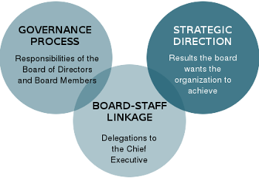
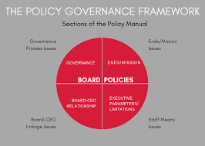
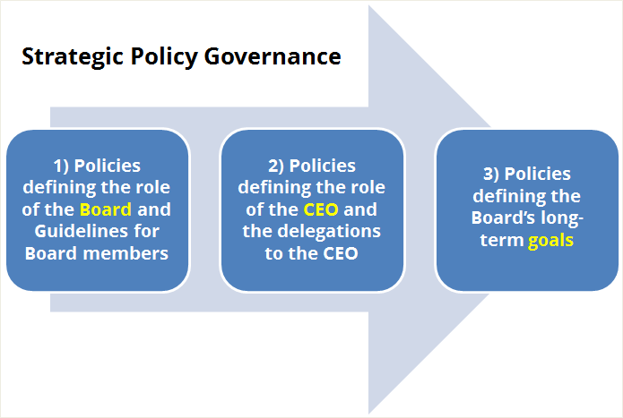
Policy Governance

Slide 24
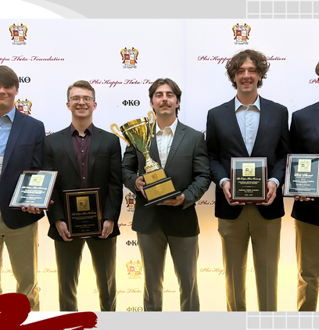

PKT as a Planning Focused Organization

Slide 25
Timeline
2007 – 2011
Rob Stalder and Kevin Lampe
Conducted in partnership with Foundation; led by Ted Hellman (Missouri); today’s mission, vision, revised end states (values/outcomes) created
2011 – 2015
Nathan Rues and Larry Dorocke
Several tactics and metrics
2015-2019
Nathan Rues and Adrian Gonzales
Revisit End States
Fewer Goals, Tactics and Metrics (2018)
Quadrants of Performance to Prioritize Resource Allocation
Closures of chapters
2019-2023
Doug Dilling and Matt Runkle
Today
Four Broad Goal Areas
Mattison Migration
COVID
Working toward synergy
Building on past efforts
Communicating Progress

Slide 26
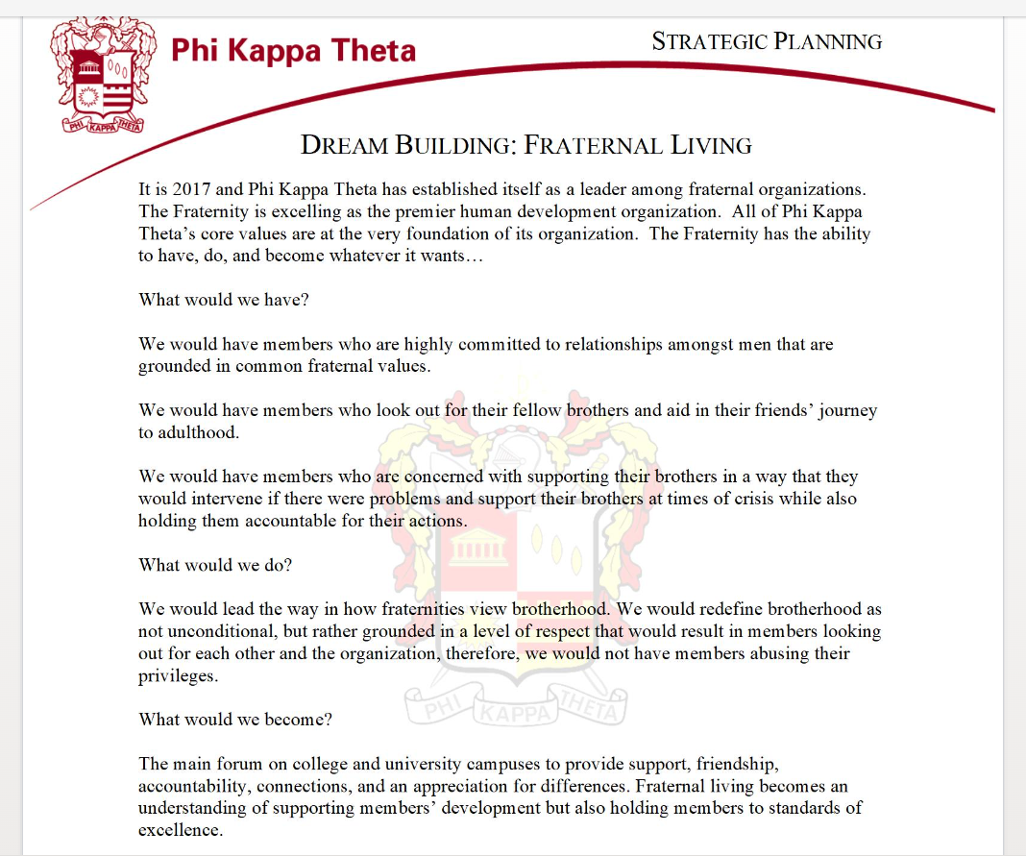
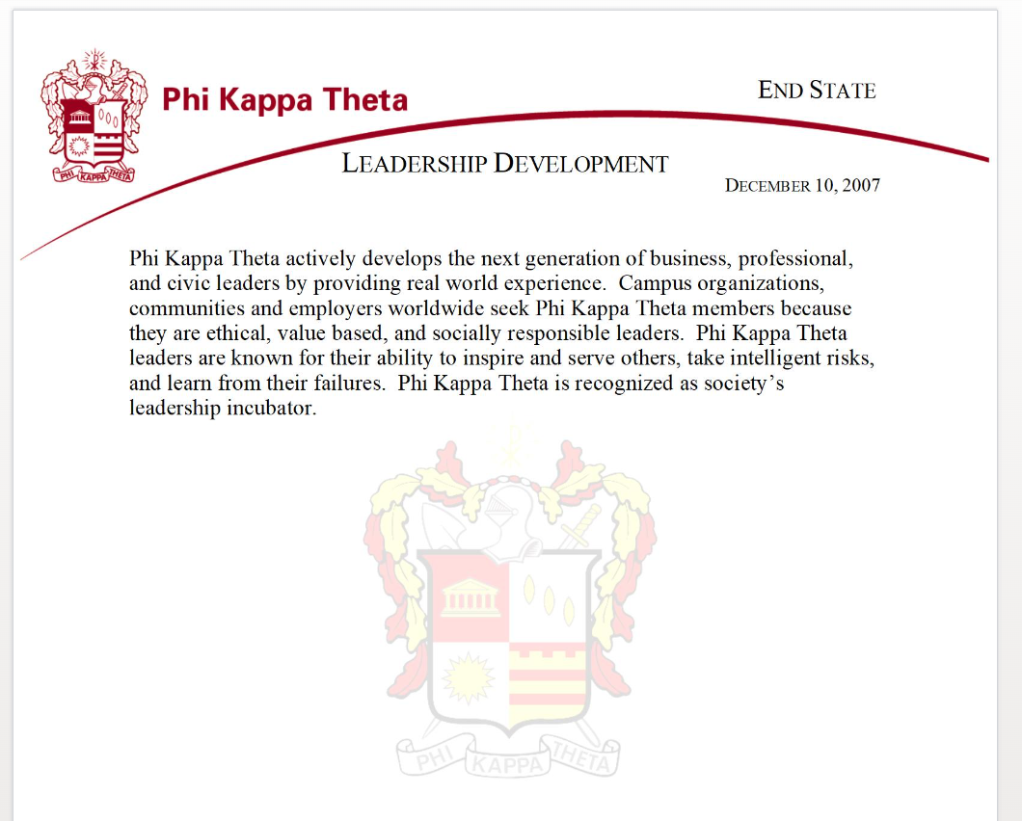
2017

Slide 27
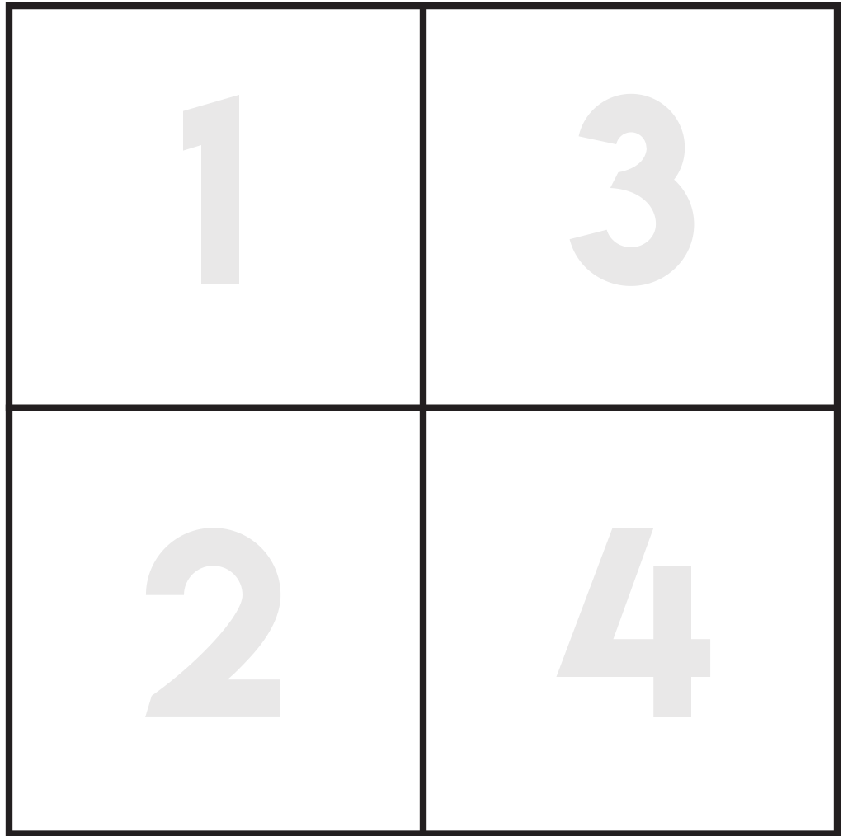
2020 Strategic Goals
Member
Success
Health &
Safety
Fraternity
Growth
Business
Operations

Slide 28
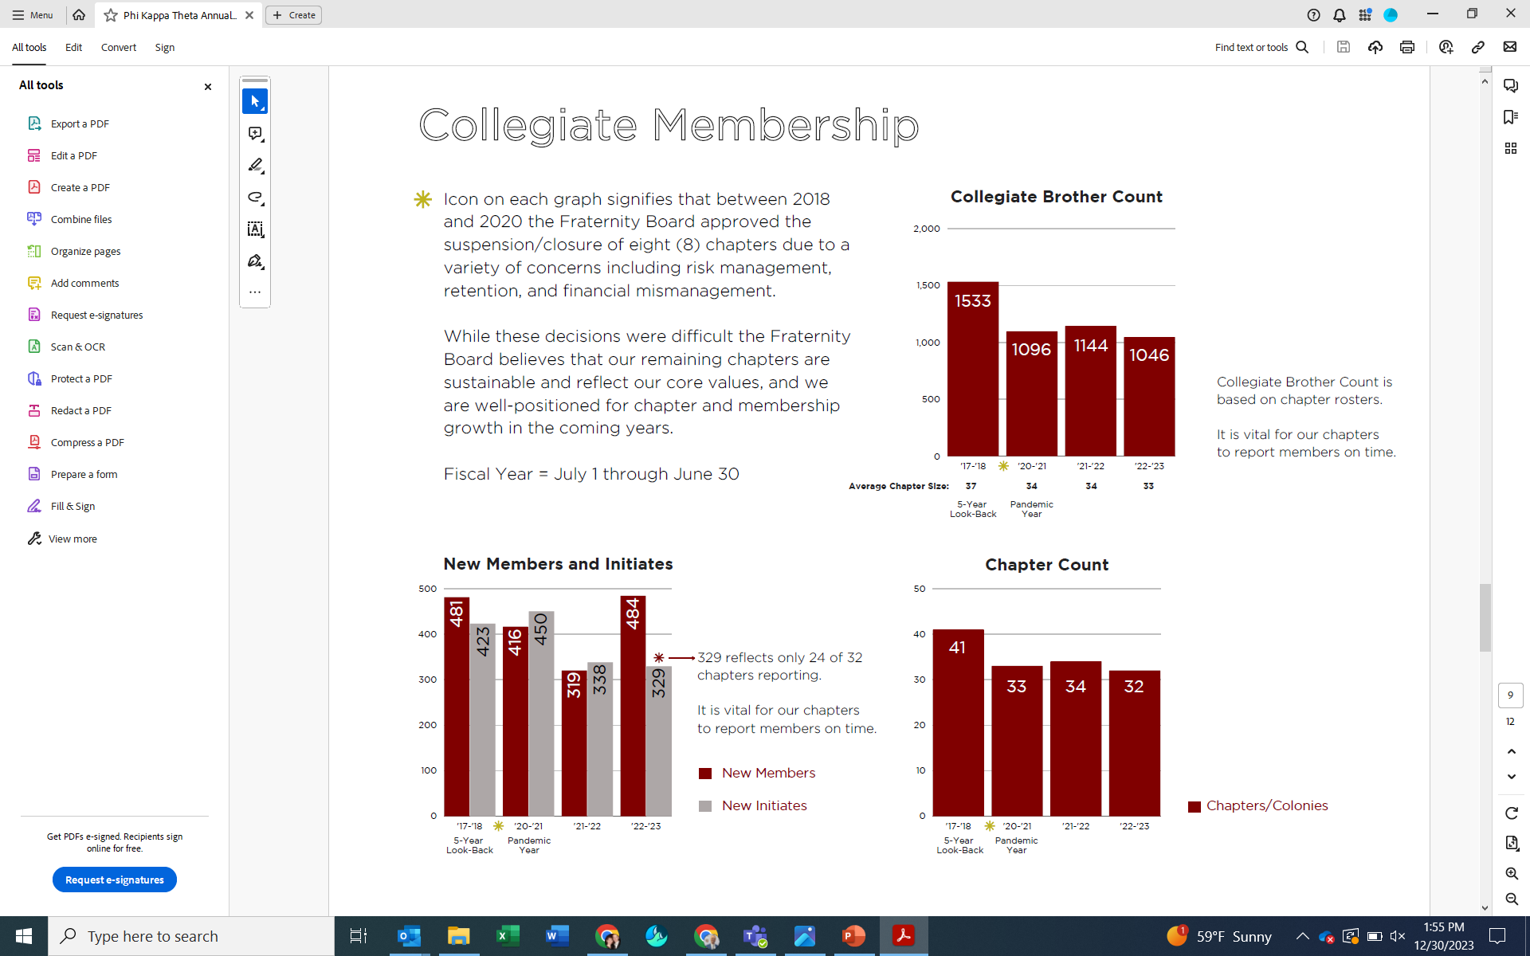

Slide 29
Contents of Current Plan
Mission (Board Role) - is the core purpose of why Phi Kappa Theta exists. It represents the way in which we behave every day.
Vision (End States) (Board Role) - is the goal that we are focusing on for the future. End States provide a more detailed picture in each of the five areas of development the Board has defined for our envisioned future if we live out our Mission.
Strategy (EVP Role/Board Reflection and Investment) - the 'how' we invest our energy and resources into achieving the Vision and End States.
Tactics (EVP Role) - the 'what', specific actions, partnerships, personnel and programs executed by the Fraternity.
Metrics (Board Role) - the specific measures utilized to define success. Annually, Goals and Metrics are set by the Board to move Phi Kappa Theta closer to the Vision and End States of the Fraternity.

Slide 30
Mission - Phi Kappa Theta actively develops men to be effective leaders who passionately serve society, Fraternity and God.
Vision - Phi Kappa Theta will be known as the premier human development organization inspiring confidence through life experiences.

Slide 31
End States:
Leadership (2011) - Phi Kappa Theta actively develops the next generation of business, professional, and civic leaders by providing real world experience. Campus organizations, communities and employers worldwide seek Phi Kappa Theta members because they are ethical, value based, and socially responsible leaders. Phi Kappa Theta leaders are known for their ability to inspire and serve others, takes intelligent risks, and learn from their mistakes. Phi Kappa Theta is recognized as society’s leadership incubator.
Fraternal - Phi Kappa Theta is a committed journey of lifelong brotherhood. Phi Kappa Theta maintains its relevance through a valuable network of collegiate and alumni members. Phi Kappa Theta challenges its members to accept responsibility for all Brothers, their communities and society.
Intellectual - Phi Kappa Theta attracts intellectually motivated men who share a passion for lifelong knowledge, learning and development. Phi Kappa Theta exceeds retention rates, average GPA’s and graduation rates of our host institutions by providing an intellectually stimulating environment and consistent standards of academic performance. Phi Kappa Theta challenges members to maximize their lifelong personal and professional development.
Societal (prev. social) - Phi Kappa Theta fosters human development through community service and social interaction. Phi Kappa Theta members are socially engaged, recognizing their responsibility to affect positive change in themselves and others. Phi Kappa Theta’s values are demonstrated through the actions of our members, who better their communities as citizens in a global society.
Spiritual - Phi Kappa Theta Brothers explore their natural curiosity about spirituality and individual purpose. Phi Kappa Theta’s Ritual is a guide to help men develop spiritually. Phi Kappa Theta embraces its Catholic heritage, welcomes diversity, and embodies the moral values upon which it was established.

Slide 32
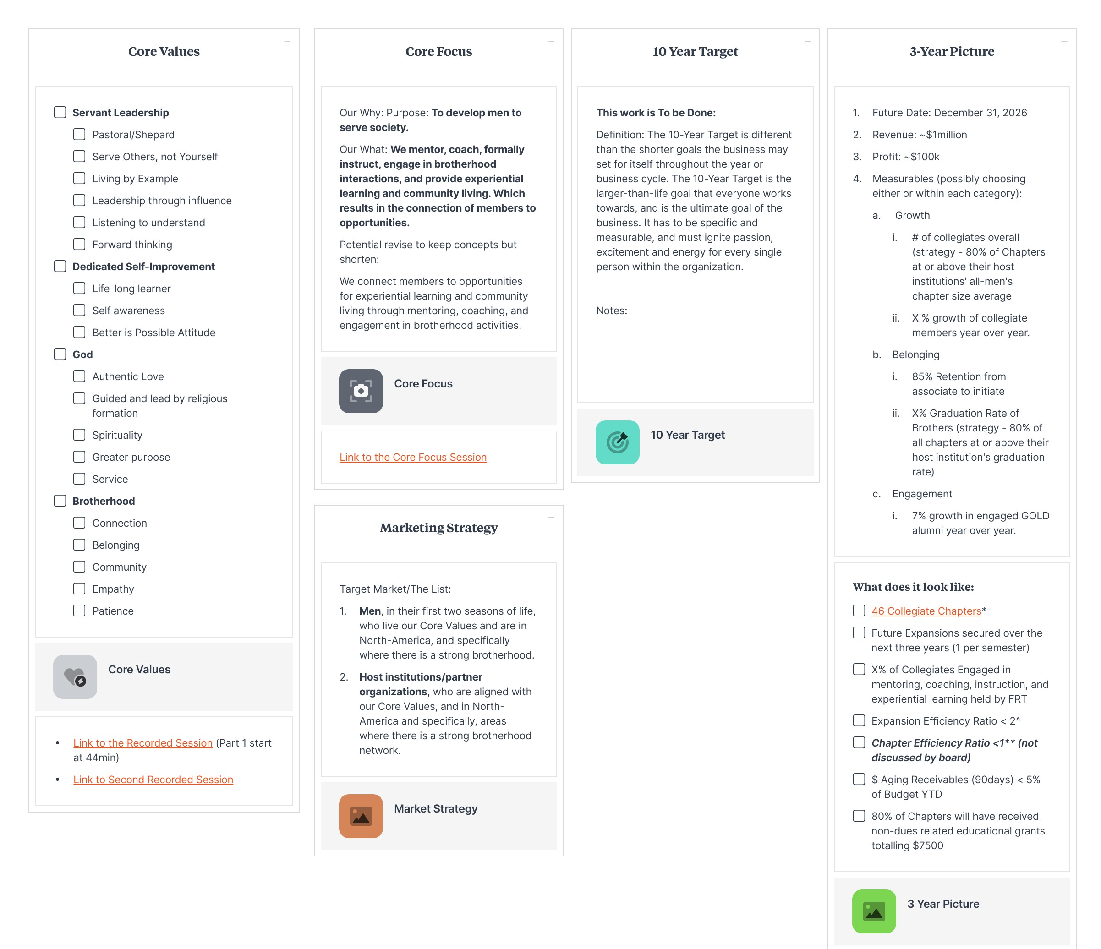

Slide 33
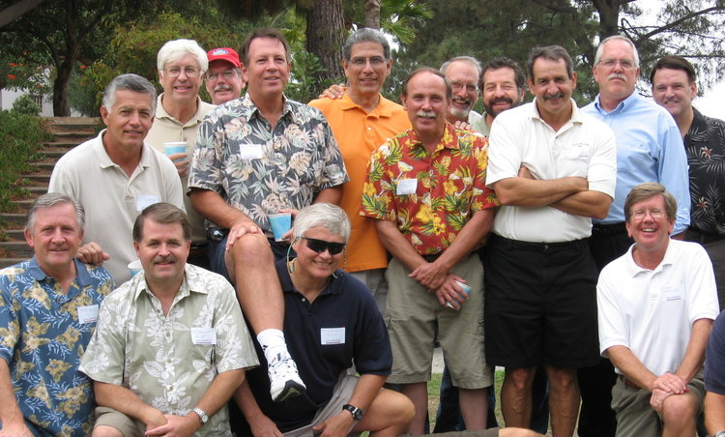
PKT as a Strategic Thinking Organization

Slide 34
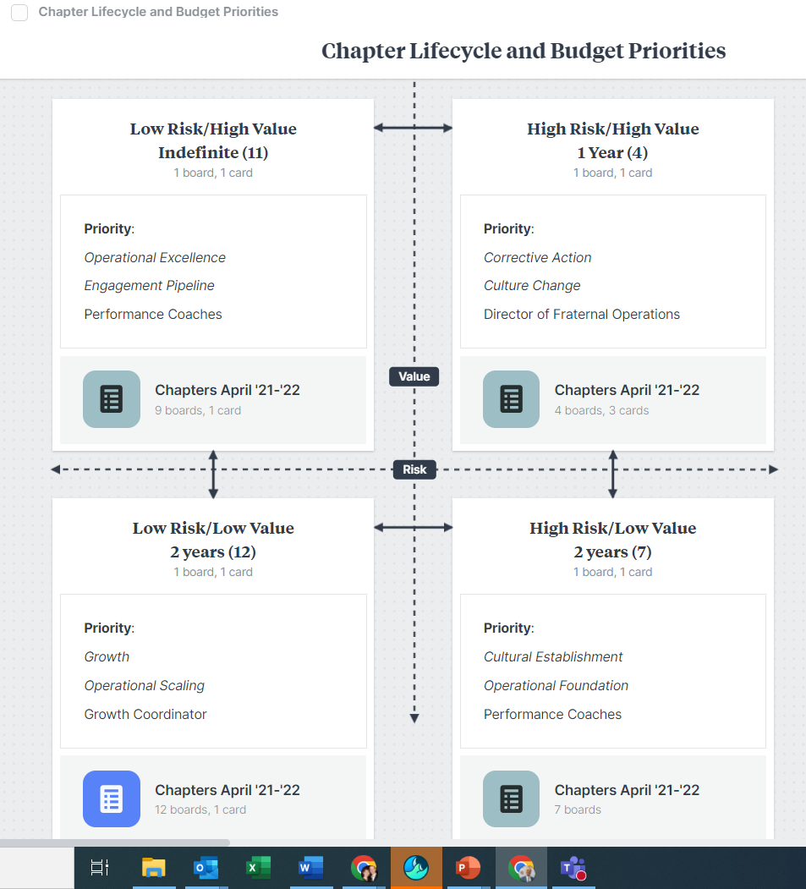

Slide 35
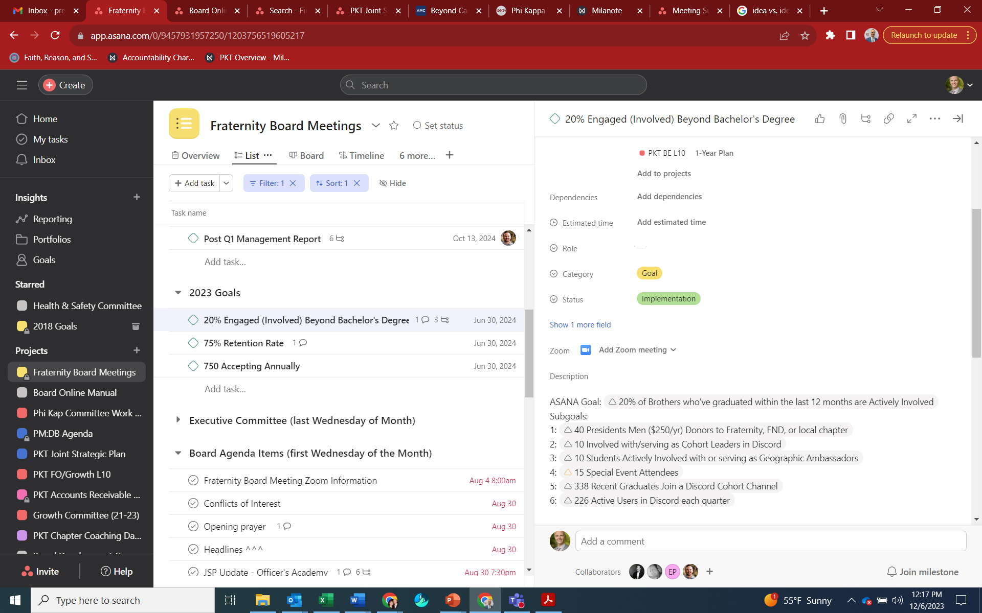
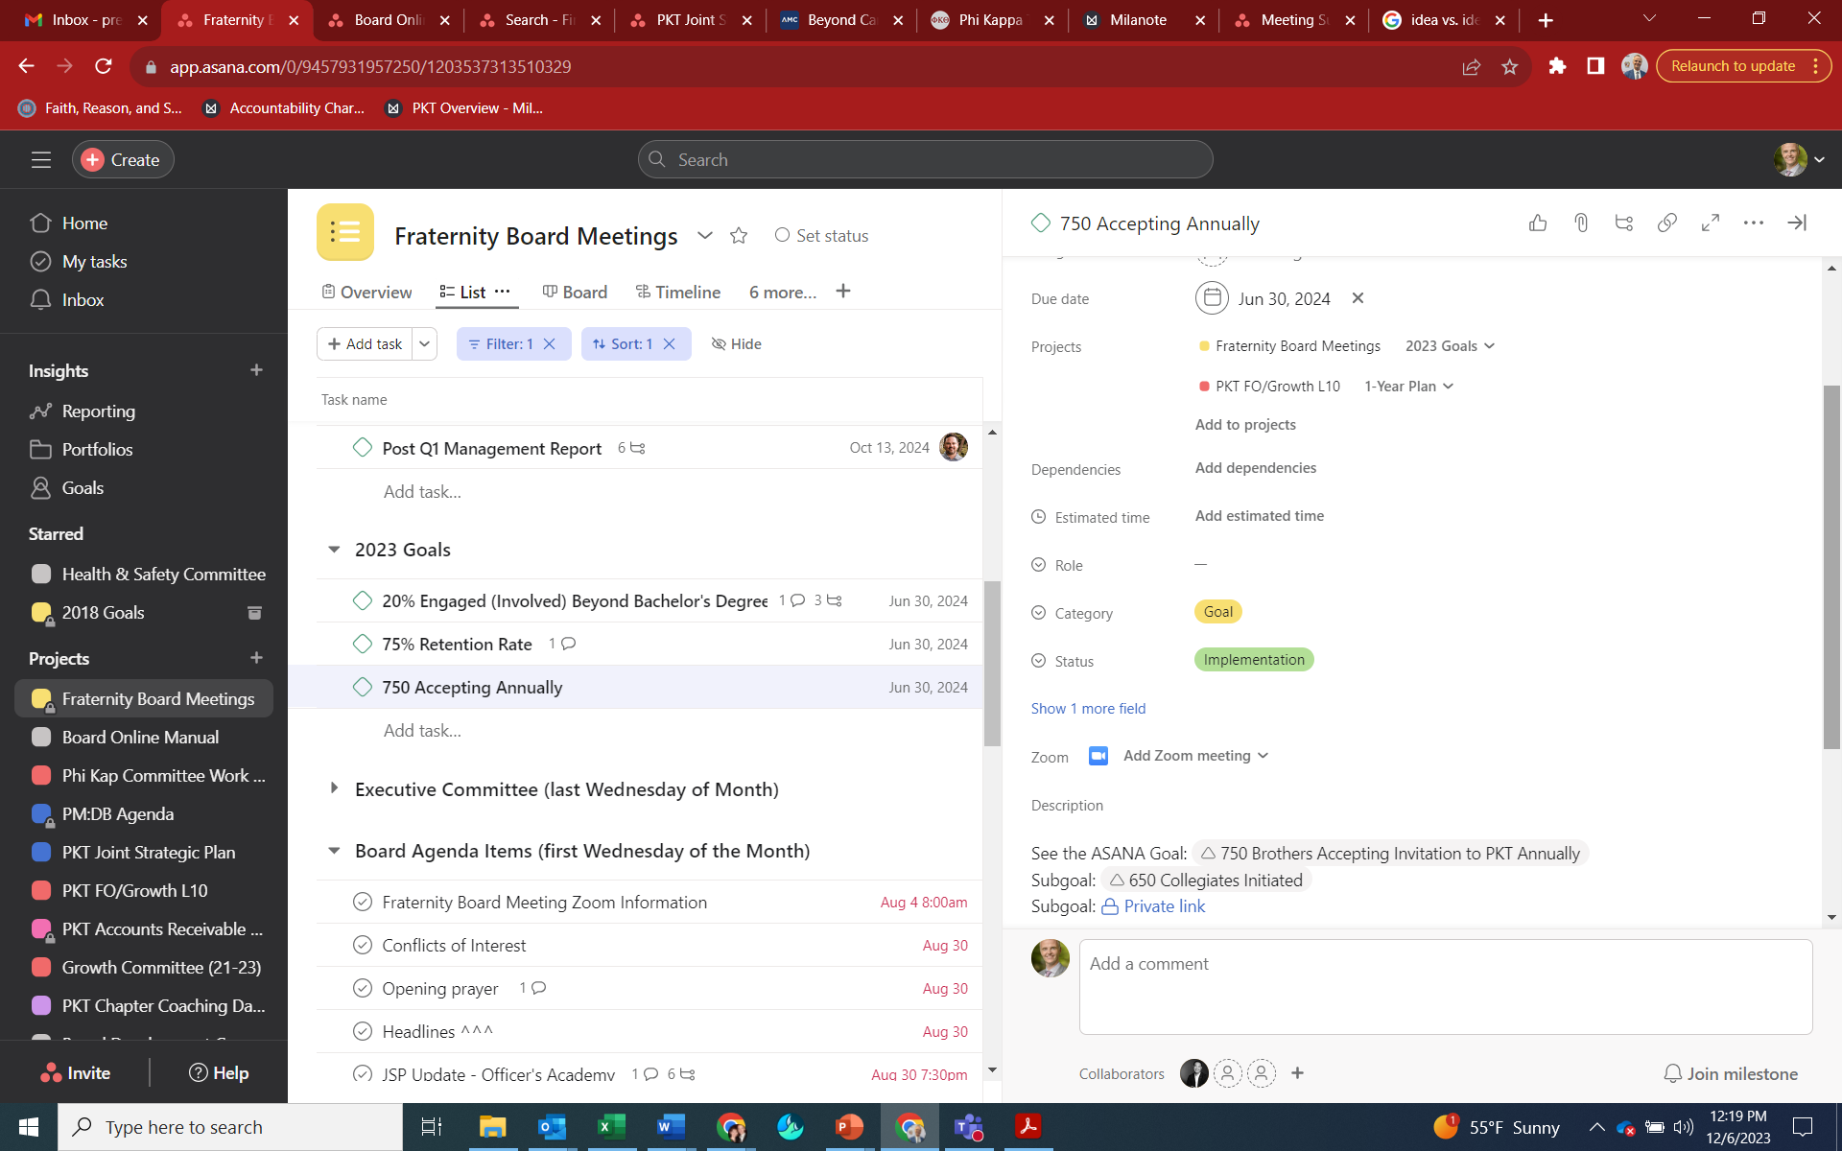
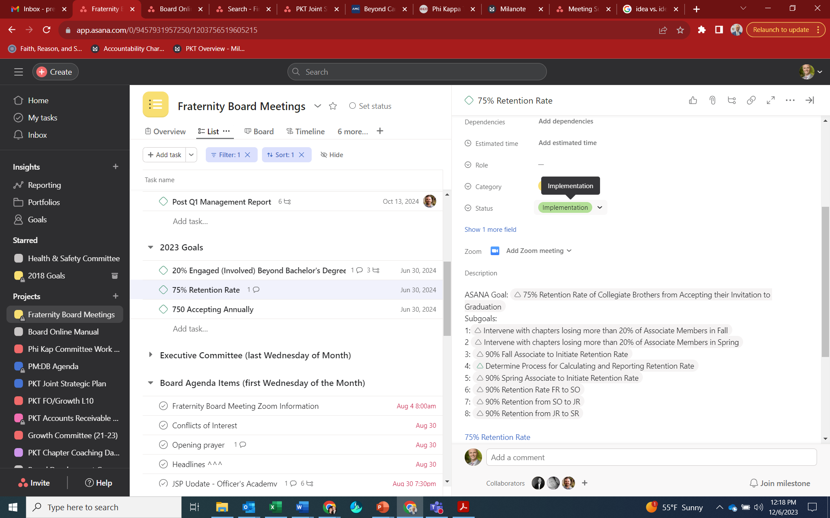

Slide 37

Challenges to strategic approach for PKT
Identifying Opportunities

Slide 38

Resources
Capacity
Communication
Commitment
Creativity
Progress

Slide 39
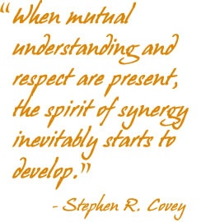
The Future: Synergy

Slide 40


Questions and Comments
Dan Bureau

Slide 41


Break
Facilitator Team

Slide 42
Foundation Presentation
Wally Kronzer

Slide 43

Foundation Strategic Plan
January 7, 2024
Wally Kronzer Foundation Chair 2024-2025
Ken Heys Past Foundation Chair 2020-2023

Slide 44
Mission Statement:
“To generate sustainable financial support for the fraternity's educational, religious philanthropic, and operational needs through strategic fundraising initiatives."

Slide 45
Vision Statement:
"A robust and diversified funding structure ensuring the long-term growth and success of our fraternity's mission and initiatives."

Slide 46
Goals:
Long-Term Goals:
  Establish a diversified fundraising portfolio to support fraternity programs and initiatives.
      Direct appeals to Annual Fund
      Appeals to Chapter Funds
      Planned Giving
      Endowed Programs
  Special Event Donations
  Regional Events /
  Founders Day of Giving
  Estate Donations

Slide 47
Objectives:
  Cleanup Contact Management Database (Bloomerang or Other/New)
    Basic Database Cleanup (Standardization, Verification, Updates)
    Data Enrichment (Wealth Screening, Biographical Information)
    Establish Regular Schedule to keep Database Fresh
  Expand donor base by 50% through Targeted Outreach, Engagement Strategies, Chapter Champions and Third-Party Services
  Increase Annual Fundraising Revenue by 50% within Five years.

Slide 48
Strategies and Programs:
Strategies:
  Donor Engagement: Develop strong relationships with donors through stewardship and personalized communication
  Chapter Champions: Solicit individuals with intimate chapter knowledge for events and donorship
  Diversified Fundraising: Implement various fundraising methods including events, campaigns, grants, and donor cultivation.

Slide 49
Strategies and Programs (con’t.):
Programs:
  Annual Fundraiser Gala: Host a signature event showcasing fraternity achievements, inviting alumni, community leaders, and potential donors.
  Online Giving Campaigns: Run targeted digital campaigns focusing on specific initiatives and projects to attract broader donor support.
  Grant Acquisition: Identify and apply for grants from foundations and corporations aligned with the fraternity's mission.

Slide 50
Allocation of Resources (Time, Talent & Treasure):
Time:
  Sensitive Management of time and bandwidth of board
Talent - (Human Resources):
  Employ a Dedicated Development Staff / Board members with
  Engage fundraising consultants to execute strategies quickly and effectively
Treasure – (Financial Resources):
  Basic Foundation Infrastructure,
  Expansion and Refinement
  Donor, Grant and Board
  Management Software
  Event Planning
  Marketing Materials and Donor Gifts
  Professional Fundraising Services
  Special Programs and Projects

Slide 51
Monitoring and Evaluation:
Performance Metrics:
  Track fundraising revenue, donor retention rates, average donation size, and engagement levels.
Evaluation Framework:
  Assess the success of individual campaigns, events, or strategies against predefined benchmarks.

Slide 52
Partnerships and Collaboration:
Strategic Partnerships:
  Collaborate with companies for matching gift programs, local businesses for sponsorships, and other organizations for joint fundraising initiatives
Stakeholder Engagement:
  Engage fraternity alumni, current members, Businesses, and community leaders in fundraising efforts.
Competitive Engagement:
  Establish working relationships with other foundations. How do they succeed? What can we learn from them and what can they learn from us.

Slide 53
Communication and Outreach:
Messaging:
  Develop compelling narratives highlighting the fraternity’s history, impact and success stories to attract and expand donors.
Engagement:
  Regularly communicate with donors through newsletters, social media, personalized correspondence and telephone calls.

Slide 54
Adaptation and Flexibility:
Regular Review:
  Analyze fundraising strategies and results annually
  Adapt based on donor feedback,
  Review emerging and changing market trends
  Evaluate effectiveness of alternative fundraising methods
  Review our competitor’s effectiveness

Slide 55
Risk Management is:
  Identification of Risks
  Mitigation Strategies

Slide 56
Risk Management:
Identify Risks which may include:
  Fatigue (Board & Donor)
  Key Donor Dependency
  Attrition of Donor Numbers and Average Donation
  New Donors Acquisition
  Operational Challenges
  Economic Downturns Affecting Donations
  Potential Negative Publicity
  Changing Social Dynamics

Slide 57
Risk Management:
Mitigation Strategies:
  Diversify Fundraising Efforts
  Expand and Refresh board capacity
  New Donor Targets & Engagement
  Maintain transparent communication with donors
  Contingency plans for unexpected financial challenges
  Outsource Tasks and certain management functions

Slide 58
Closing Summary:
Foundation Strategic Planning Includes:
  Clear Mission and Vision
  Strong Leadership and Governance
  Financial Sustainability
  Effective Programs and Impact Measurement
  Partnerships and Collaboration
  Transparency and Communication
  Adaptability, Innovation and Risk Management
  Continuous Engagement, Learning, Improvement and Inclusivity
Divide and Conquer:
        Foundation Management, Foundation Success and Fraternity Success is a compilation of full-time job(s) shared by many.

Slide 59
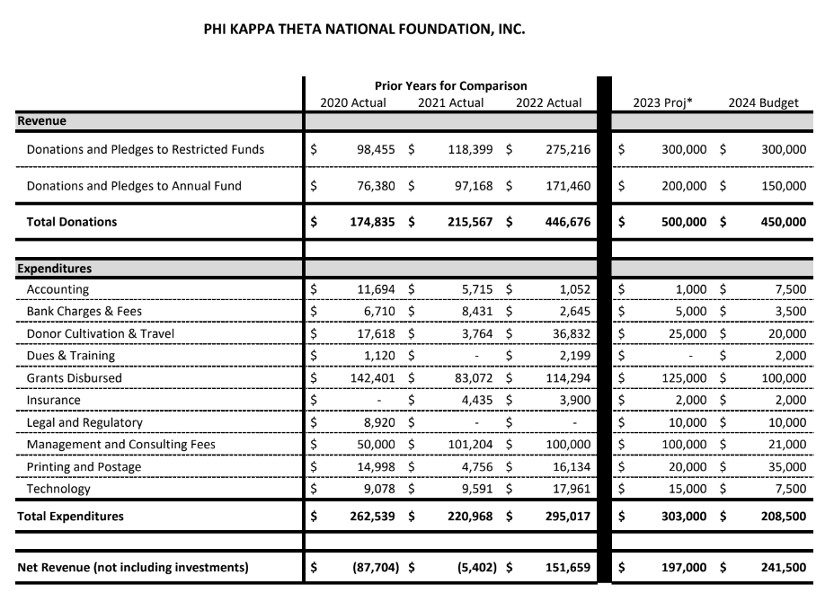

Slide 60
Questions and Comments

Slide 61
Wrap Up
Immediate Priorities
  Team leads and staffing
  Team task statements
  Framework feedback survey
Reactions around the screen – “One Word” in the Chat Window
Other announcements
Upcoming Events

Slide 62
Upcoming Events
Tuesday 20 February 8:00 pm EST – PC Session 5
Tuesday 19 March 8:00 pm EDT – PC Session 6
Saturday 27 April 9:00 am CDT – PC Session 7 (3-hour hybrid session held in
Ames, IA in conjunction with the Iowa Xi Centennial Celebration)
Monday 29 April – Founders Day
Tuesday 21 May 8:00 pm EDT – PC Session 8
TBD July/August – PC Session 9 (3-hour hybrid session to be held in
conjunction with an UG educational experience, location TBD)
17 September 8:00 pm EDT – PC Session 10
15 October 8:00 pm EDT – PC Session 11
19 November 8:00 pm EST – PC Session 12

Slide 63
Backup Slides

Slide 64
Ground Rules – 18 Survey Responses
Give honest and constructive feedback
Focus on what’s best for the long-term of the fraternity
Agree/Disagree on ideas, not members of the organization
Adhere to your commitments and stay engaged
Open and frequent communication/accountability
Think boldly and bring forth big ideas, but consider resources
Use examples, not generalizations
Be patient, and also flexible
Consider the undergraduates and the founders

Slide 65
Expectations – 18 Survey Responses
Based on your understanding of what was covered during Session 1 and the timeline to complete a Joint Strategic Plan (JSP) by May 2025, what are your expectations about the process for formulating a JSP?
Based on these results, our brothers expect an open, transparent, and well-communicated process that actively solicits participation from a wide cross-section of members and external stakeholders. Regular updates should be communicated to our entire membership to promote engagement and instill confidence in progress. Further, our brothers understand the complexity of the planning initiative and stress the need for smaller, focused working groups to drive outcomes.
What are your expectations about the results of a JSP?
By the end of the process, respondents expect a clear, forward-looking plan with a core focus on growth. Therefore, we should work to better define key areas that contribute to the growth of a fraternity and fraternal foundation, particularly emphasizing complementary areas between both organizations. With a large emphasis on implementation, the resulting strategic plan should have well-defined and measurable goals.

Slide 66
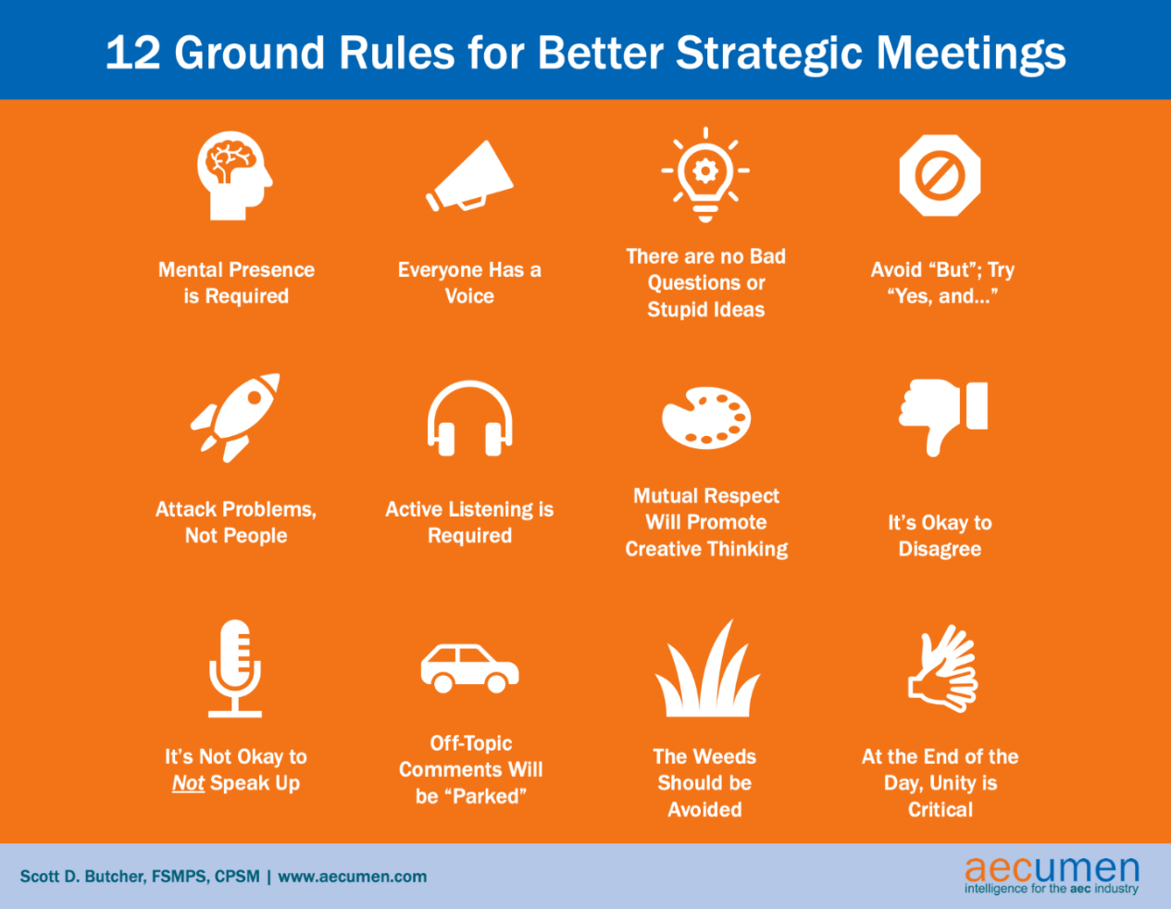

Slide 67
Purpose – 18 Survey Responses
A defined process will enable us to develop a common vision for Phi Kappa Theta
Help bring alignment between the leadership of the Fraternity and Foundation
Ensure we create an achievable and realistic plan
Establish collective buy-in of our work and promote wide participation among our membership and stakeholders
Develop trust and provide accountability between Fraternity and Foundation
A plan will provide directional guidance, specific objectives, and measurable goals that align and promote our mission, vision, and values
Ensure the long-term survival and growth of the Fraternity

Slide 68
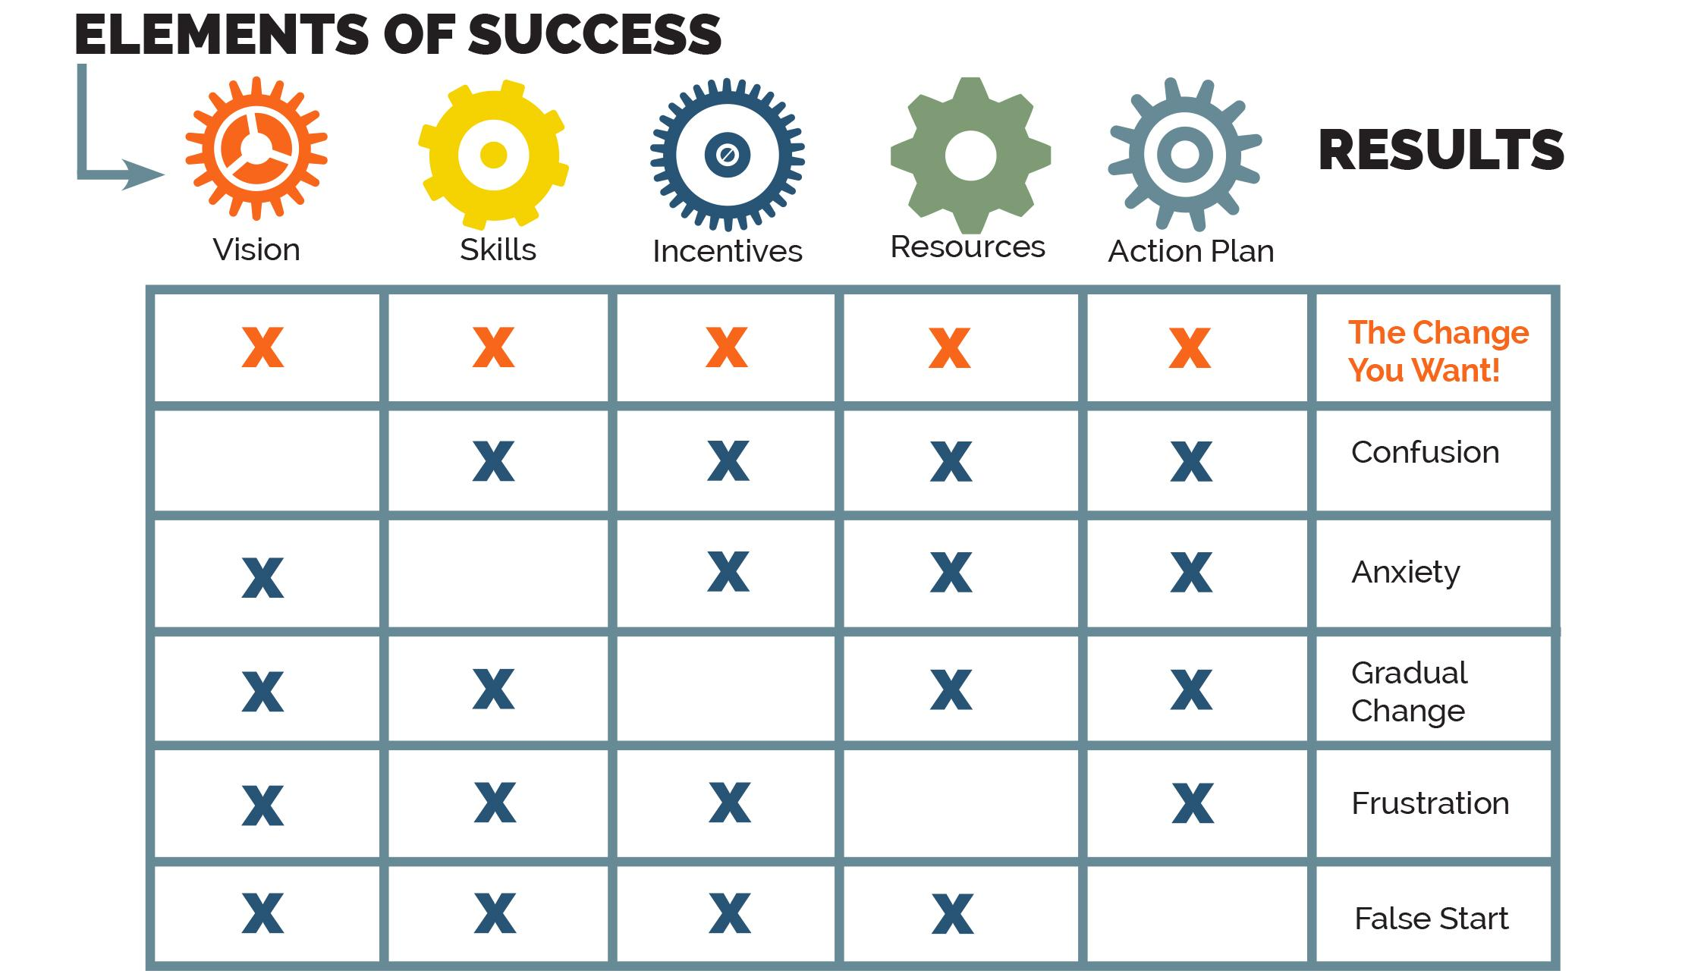
Model of Complex Change Management

Slide 69
Task Team Statements
Each Task Team will create its task statement that answers the When, What, and Why of its assigned task. The team’s name and its primary approach (research, survey, focus group, combination) will provide general guidance in answering the questions. The schedule will also help answer the when.
Task Team leads will provide additional guidance and suggestions based on input from the Planning Committee, Facilitator Team, and Co-Champions.

Slide 70
Task Statement Example
Housing Corporation Focus Group
When
From January 1 – April 30, 2024, the Housing Corporation Focus Group task team will conduct at least one virtual focus group session with alumni who are currently responsible for housing corporations for chapters.
Focus group members will be selected based on survey responses and first-hand information from chapters who have housing corporations. The team may use an initial survey to gather information. For the group session(s), the team will prepare questions for participants and lead them through discussions about how their housing corporations operate; the histories of their corporations; the services and support they receive from the national Fraternity and Foundation and local alumni; their interactions with undergraduate brothers, other campus housing corporations, and other Phi Kappa Theta housing corporations; challenges they currently face; and five- and ten-year outlooks for their housing corporations. Participants will be asked to identify housing corporation best practices and lessons learned. A summary of the focus group responses, discussions, and recommendations will be compiled in a report for the Planning Committee.
The purpose of the focus group is to determine how well chapter housing corporations are performing, the relative importance of the corporation to the success of an undergraduate chapter, and what, if any, assistance they need from the national Fraternity and/or Foundation.
What
Why

Slide 71
Proposed Staffing Summary
Assumptions
- That the RC is able to get enough volunteers to fill the teams at the minimum levels
- That a volunteer will only serve on one team
- That Planning Committee members will serve as Team Leads
Staffing Mitigations
- Ask volunteers to serve on more than one team
- Reduce the number of minimum members
- Merge two or more teams into a single team
 | Committee and Team Participants
 | Min | Max | PC Leads
3 Committees | 42 | 108 | 4
3 Standing Teams | 10 | 19 | 5
27-34 Task Teams | 126 | 246 | 34
Totals | 178 | 373 | 43

Slide 72
JSP Content from the Plan Phase
Key Result Areas: Key Result Areas or KRAs are the overarching thematic focuses for our work throughout the duration of the plan.
Our plan should be limited to 3-5 KRAs. Big Hairy Audacious Goals (BHAGs) typically sit at the KRA level.
Goals: Under each KRA will lie 2+ Goals. Goals are the major accomplishments necessary to make progress toward the accomplishment of the KRA. Their timelines are usually 2+ years, though may not be time-bound.
Objectives: Under each goal may lie at least one objective, often several. Their timelines are usually 1-2 years. Objectives are the action steps required to accomplish the goal. Objectives should be SMART (Specific, Measurable, Achievable, Relevant, and Time-bound).

Slide 73
JSP Content from the Plan Phase (con’t.)
Metrics: Every objective must have at least one defined measure of success. Metrics are often quantitative - transactional or activity-based. Metrics can be qualitative or how well the organization is doing something (e.g., customer service). The organization must have tools and processes in place to gather data for metrics and report them consistently. The best metrics are SMART and performance-based. If you can’t or won’t measure something, don’t use it as a metric.
A Key Performance Indicator (KPI) is a single metric that is commonly used to report progress against an objective or even a goal, often in a dashboard. It is always SMART and performance-based.
Impact(s): Though not mandatory, it’s often helpful to note the desired impact(s) of each KRA. Impact statements are narrative descriptions of what is expected if the KRA is achieved.

Slide 74
JSP Implementation and Impacts
JSP Implementation – Phase V
Annually, champions and planners assess the performance of both organizations and prepare new annual operating plans. They ensure the annual operating plans support the joint strategic plan.
Annually, champions and planners inform audiences and stakeholder groups of annual progress against the strategic plan and solicit feedback.
One year prior to the end of the joint strategic plan period, both organizations prepare to update the strategic plan using a mutually agreed upon framework.
Impacts of Creating a Joint Strategic Plan
During
  Increased workload and reprioritization of some tasks for staff, leaders, and volunteers
  Reallocation of resources – time and money
After Completion
  Increased effectiveness and efficiency of resources
  Increased accountability and responsibility
  Increased awareness of performance against annual operating plans
  Increased definition to priorities and programs, which indirectly helps with fundraising, recruiting new members, and establishing new chapters or recolonizing chapters

